Slide 1

DATA VISUALIZATION ASSIGNMENT · POWER BI
Namma Yatri: Ride Analytics Dashboard
Sakshi Ghodeswar
A Power BI deep-dive into ride-hailing performance — covering trip conversion, demand patterns, zone analytics, and payment behavior across Bangalore.

Slide 2


OBJECTIVE
What We Set Out to Discover
Trip Conversion
Measure search-to-completion rates and identify drop-off points in the rider journey.
Demand Patterns
Uncover peak hours, high-demand zones, and seasonal trends across Bangalore.
Payment & Cancellation
Analyze payment method distribution and cancellation rates to surface operational friction.
Key Insight: 45% conversion rate indicates moderate performance — over half of all searches never result in a completed trip.

Slide 3


DATA PREPARATION
From Raw Data to Clean Dataset
Source & Scope
Dataset sourced from Namma Yatri's public trip logs, covering 2,161 ride searches across Bangalore zones.
Transformations Applied
Removed nulls in pickup/drop-off timestamps
Standardized zone naming conventions
Derived trip duration and wait-time columns
Flagged cancelled vs. completed trips
Key Insight: After cleaning, 983 trips were confirmed completed — a 45% conversion rate from the original 2,161 searches.

Slide 4
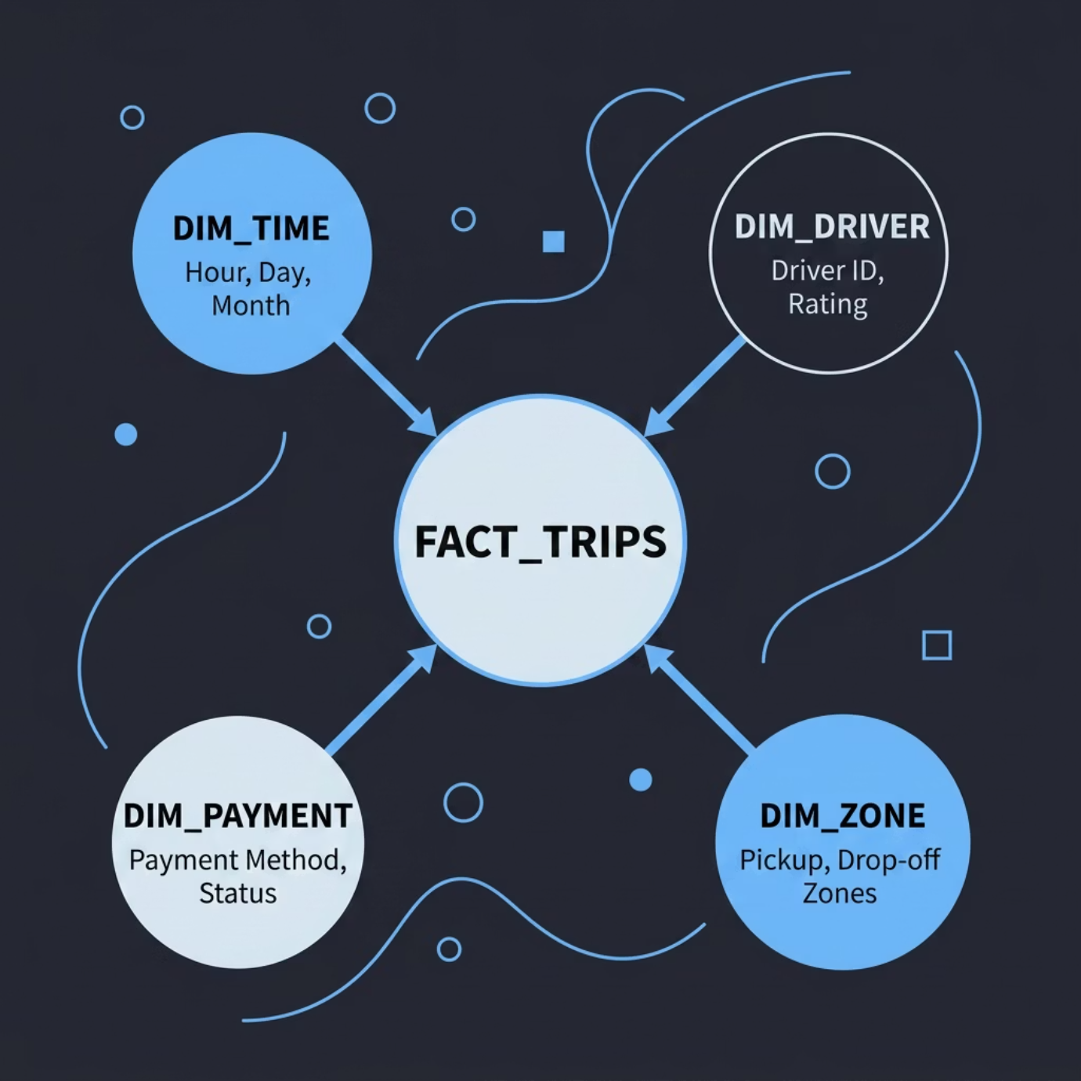


DATA MODEL
Star Schema Design
Model Structure
A star schema was built with Fact_Trips at the center, linked to four dimension tables enabling fast, flexible analysis across zones, time, payment, and driver attributes.
Relationships
One-to-many from dimensions to fact table
Active relationships on zone and time keys
Inactive relationship on cancellation flag for toggle filtering
Key Insight: The star schema reduced query complexity and enabled seamless cross-filtering across all dashboard pages.

Slide 5

DAX MEASURES
Key Metrics Built in DAX
Conversion Rate
Cancellation Rate
DIVIDE([Completed Trips], [Total Searches]) → 45%
DIVIDE([Cancelled], [Total Searches]) → 18%
Avg. Trip Duration
Peak Hour Index
AVERAGE(Trips[Duration_Min]) → 24 min
Trips per hour vs. daily average → 8–10 PM = 2.1× baseline
Key Insight: The Peak Hour Index measure revealed that evening hours (8–10 PM) generate over twice the baseline trip volume, critical for driver allocation.

Slide 6
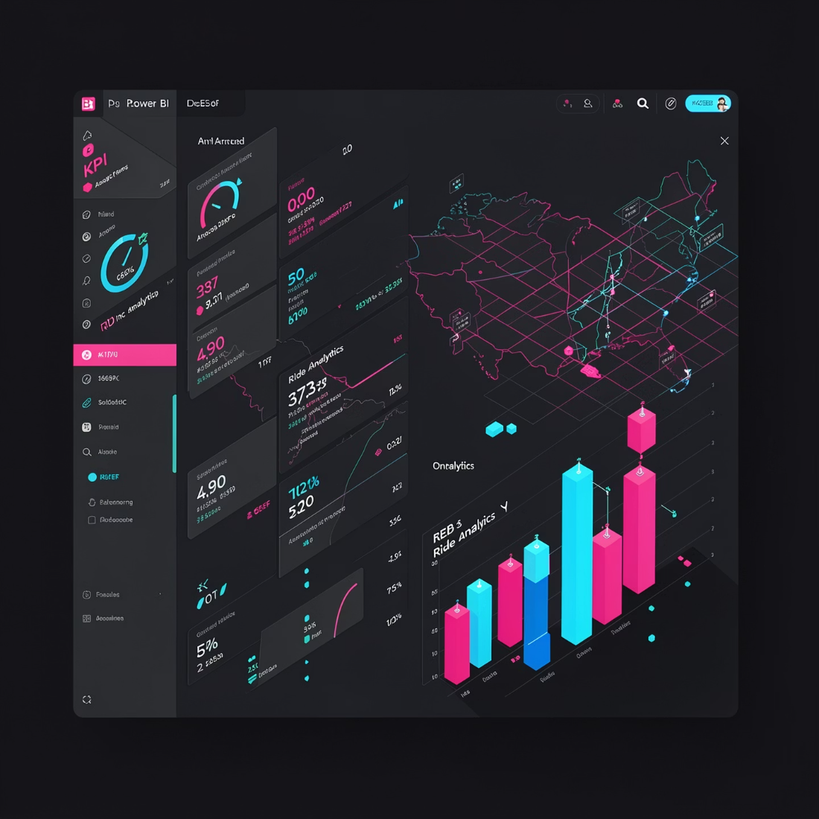

DASHBOARD · OVERVIEW
Overview Page: The Big Picture
What the Overview Shows
The landing page consolidates all critical KPIs — total searches, completed trips, conversion rate, and a zone map — giving leadership an instant health check.
2,161 total ride searches
983 trips completed
45% overall conversion rate
18% cancellation rate
Key Insight: A 45% conversion rate indicates moderate performance — over half of all ride searches never result in a completed trip, signaling significant drop-off.

Slide 7
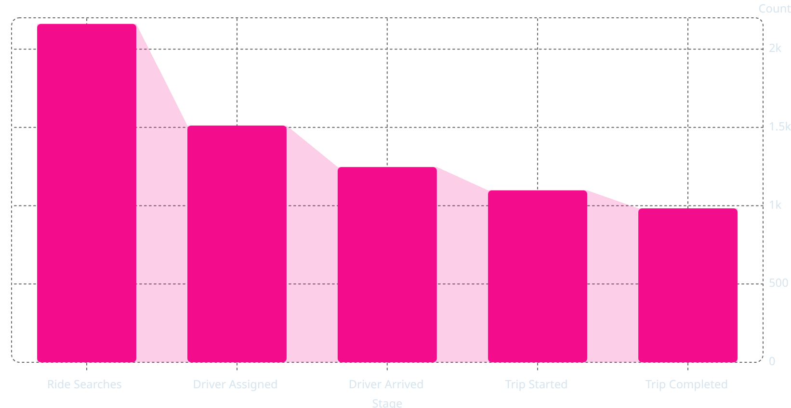

DASHBOARD · FUNNEL
Trip Conversion Funnel
45.49%
Where Riders Drop Off
Total conversion rate
The funnel reveals critical attrition: 30% of searches never get a driver assigned, and a further 17% abandon after assignment but before pickup.
Search → Assigned: 70% pass-through
Assigned → Arrived: 82% pass-through
Started → Completed: 90% pass-through
Key Insight: The largest drop-off (30%) occurs before driver assignment — indicating driver availability, not rider behavior, is the primary bottleneck.

Slide 8
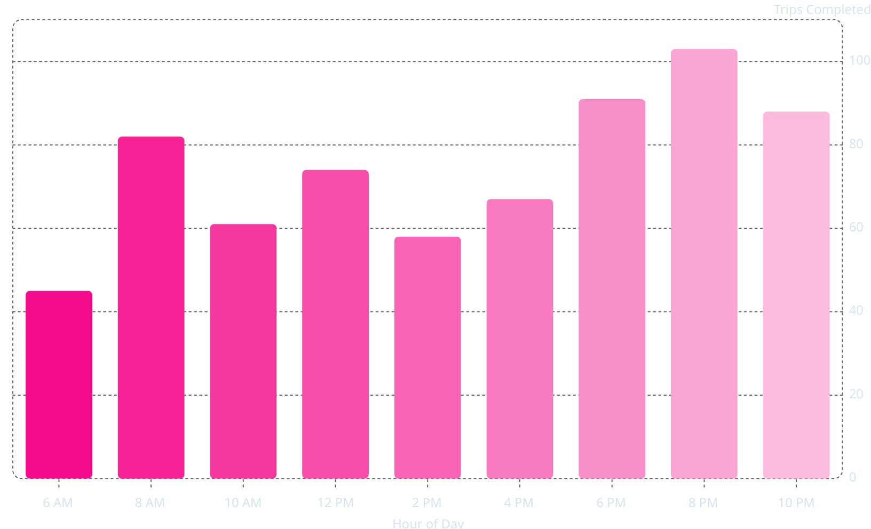

DASHBOARD · TIME ANALYSIS
When Demand Peaks
Evening Dominance
Trip volume peaks sharply between 8–10 PM, with 103 trips — 2.1× the daily baseline. Morning rush (8 AM) is the secondary peak.
Operational Implication
Driver incentives should be concentrated in the 6–10 PM window to match supply with the highest demand periods.
Key Insight: 8–10 PM generates 2.1× baseline trip volume — a clear signal for dynamic pricing and driver incentive windows.

Slide 9
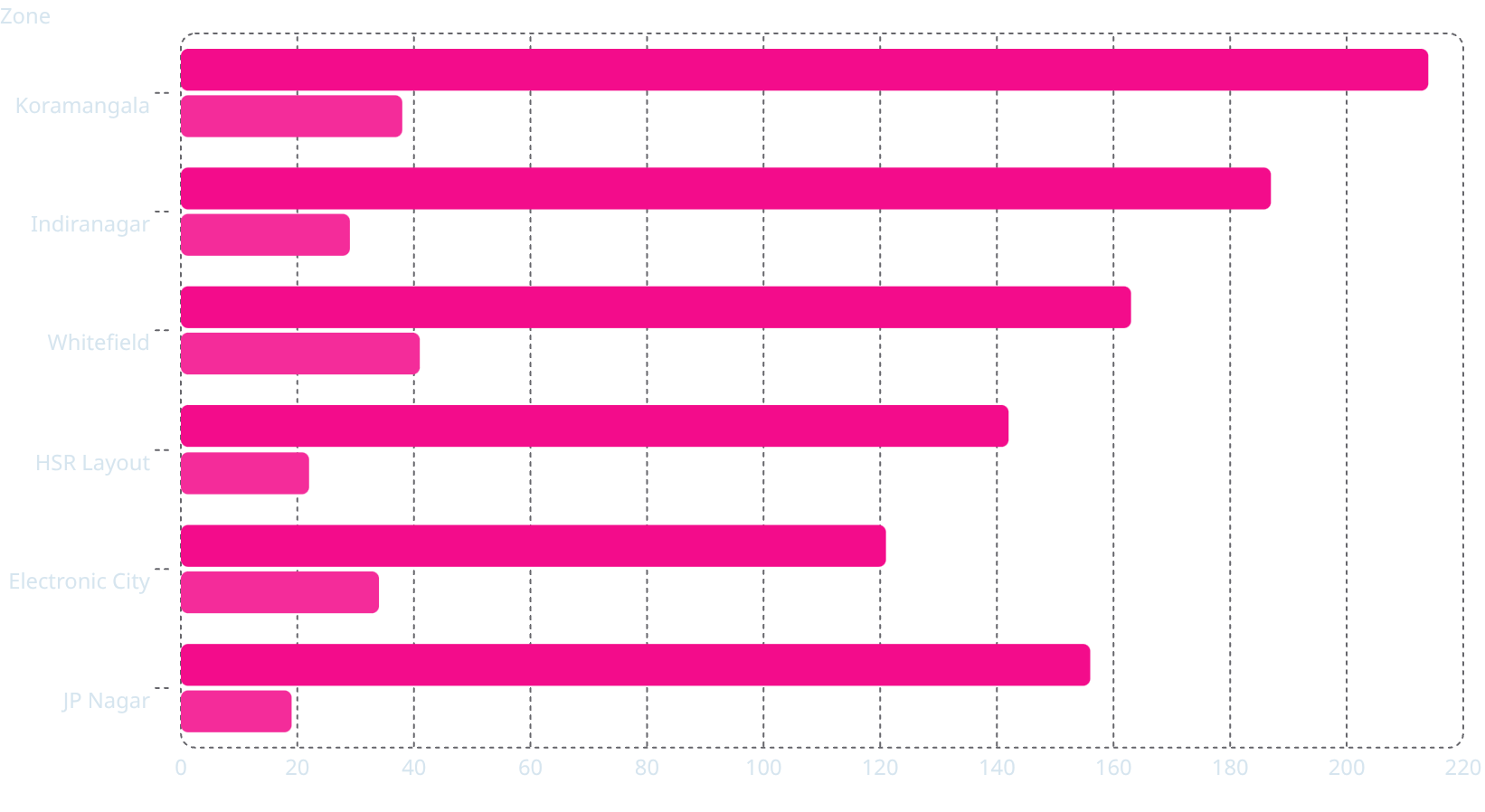

DASHBOARD · ZONE & PAYMENT
Zone Performance & Payment Behavior
Trips Completed
Cancelled
Zone Insights
Koramangala leads with 214 completed trips but also records the highest cancellations (38). Whitefield has a concerning 25% cancellation rate.
Payment Split
Cash: 61% of all trips
UPI: 32% — growing segment
Card/Wallet: 7%
Key Insight: Whitefield's 25% cancellation rate is the highest among all zones — driver supply mismatch or longer wait times are likely causes.

Slide 10


CONCLUSION
Key Takeaways & Recommendations
Improve Driver Assignment
30% of searches never get a driver — focus on driver density in Koramangala and Whitefield during peak hours.
Incentivize Evening Shifts
8–10 PM demand is 2.1× baseline; targeted surge pricing and driver bonuses can close the supply gap.
Accelerate UPI Adoption
Only 32% of trips use digital payment — cash dominance (61%) increases reconciliation overhead and fraud risk.
Monitor Whitefield Closely
25% cancellation rate demands immediate investigation — driver wait times and zone coverage are primary suspects.

